Slide 1
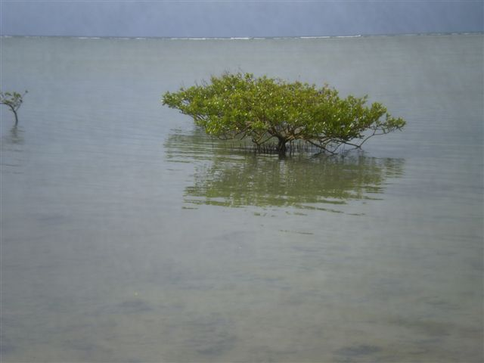
CLIMATE CHANGE EDUCATION
IN VANUATU

Slide 2
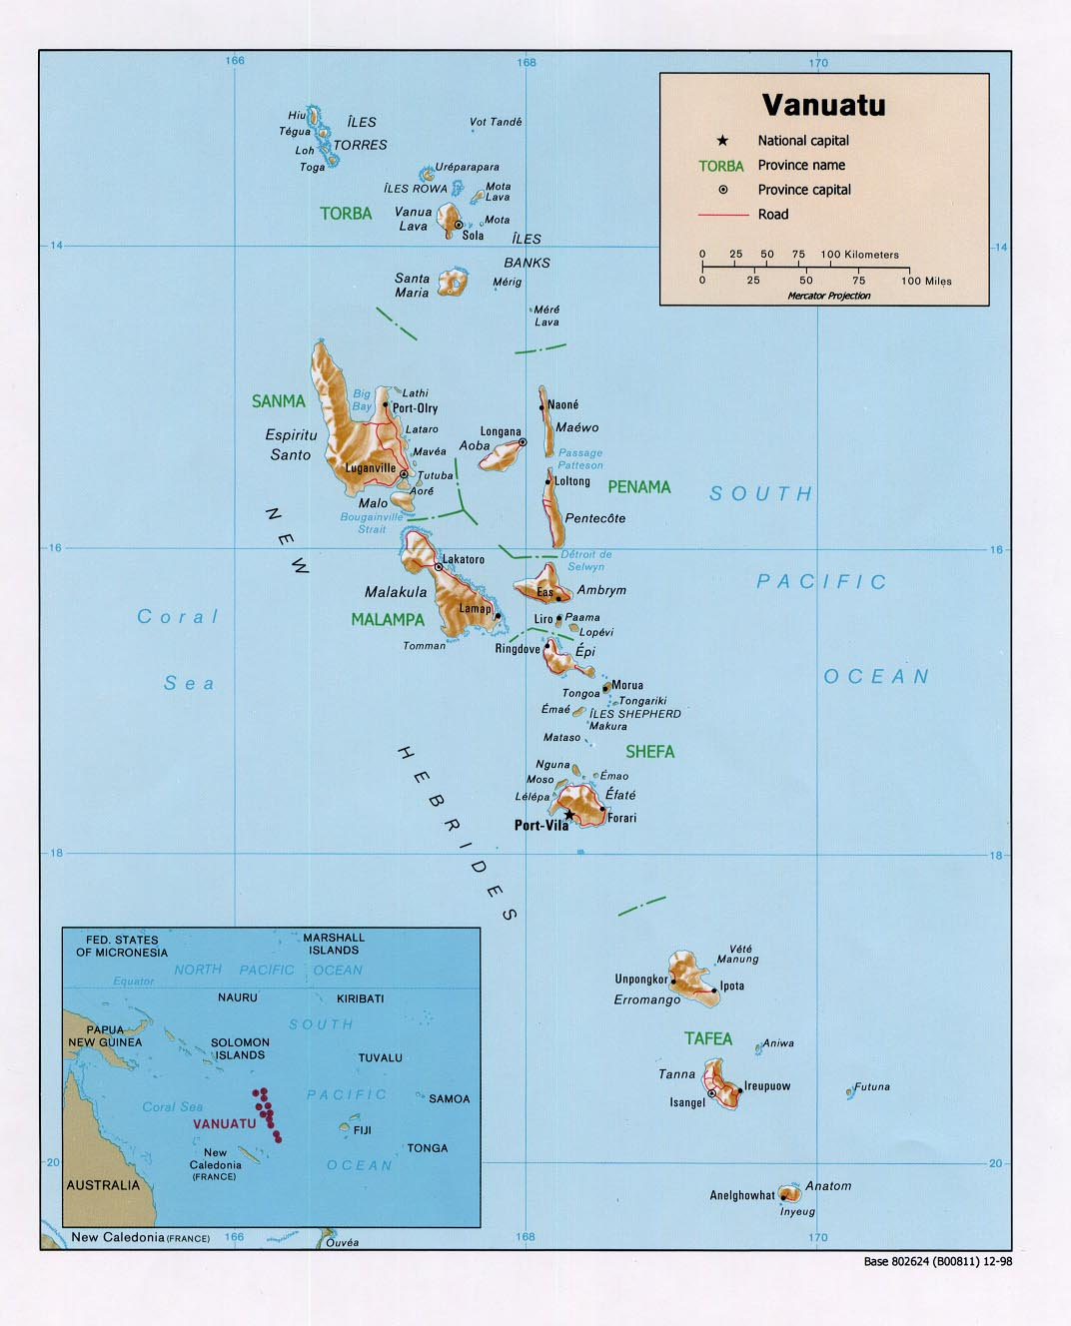
1.
BACKGROUND INFORMATION ON EDUCATION IN VANUATU

Slide 3
RECENT SUCCESSES
Vanuatu Education Road Map (VERM)
Greater Access to education
Improvement in quality of teaching and learning
Better manage-ment
of schools

Slide 4
REASONS FOR SUCCESS
Funding from EPG: NZAid, AusAid, Unicef…
Team work between locals and technical
advisers (capacity building)
Commitment of workers in the education
sector, despite lack of human resources

Slide 5
PRIORITIES IN THE EDUCATION SECTOR
Review of the curriculum from Kindergarten to Year 13, aligned with the new Vanuatu National Curriculum Statement.
Training of teachers (VITE and ISU)
Review of examinations
Improvement of infrastructure (classrooms, science labs, etc.…)

Slide 6
CHALLENGES
Lack of human and teaching resources, e.g. in curriculum development.
Lack of motivation among teachers.
Implementation of the reformed curriculum.
More effective consultation with stakeholders
Bringing the examination system into line with the reformed curriculum.

Slide 7
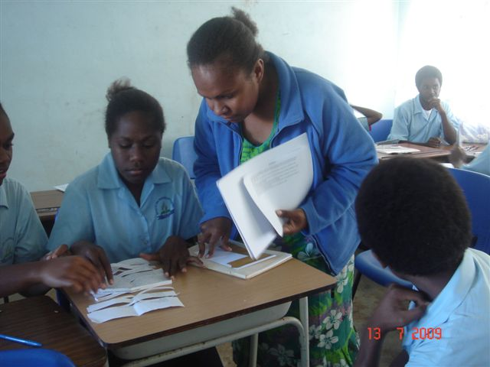
2.
CURRENT CURRICULUM AND ACTIVITIES ON CLIMATE CHANGE
FORMAL
SECTOR

Slide 8
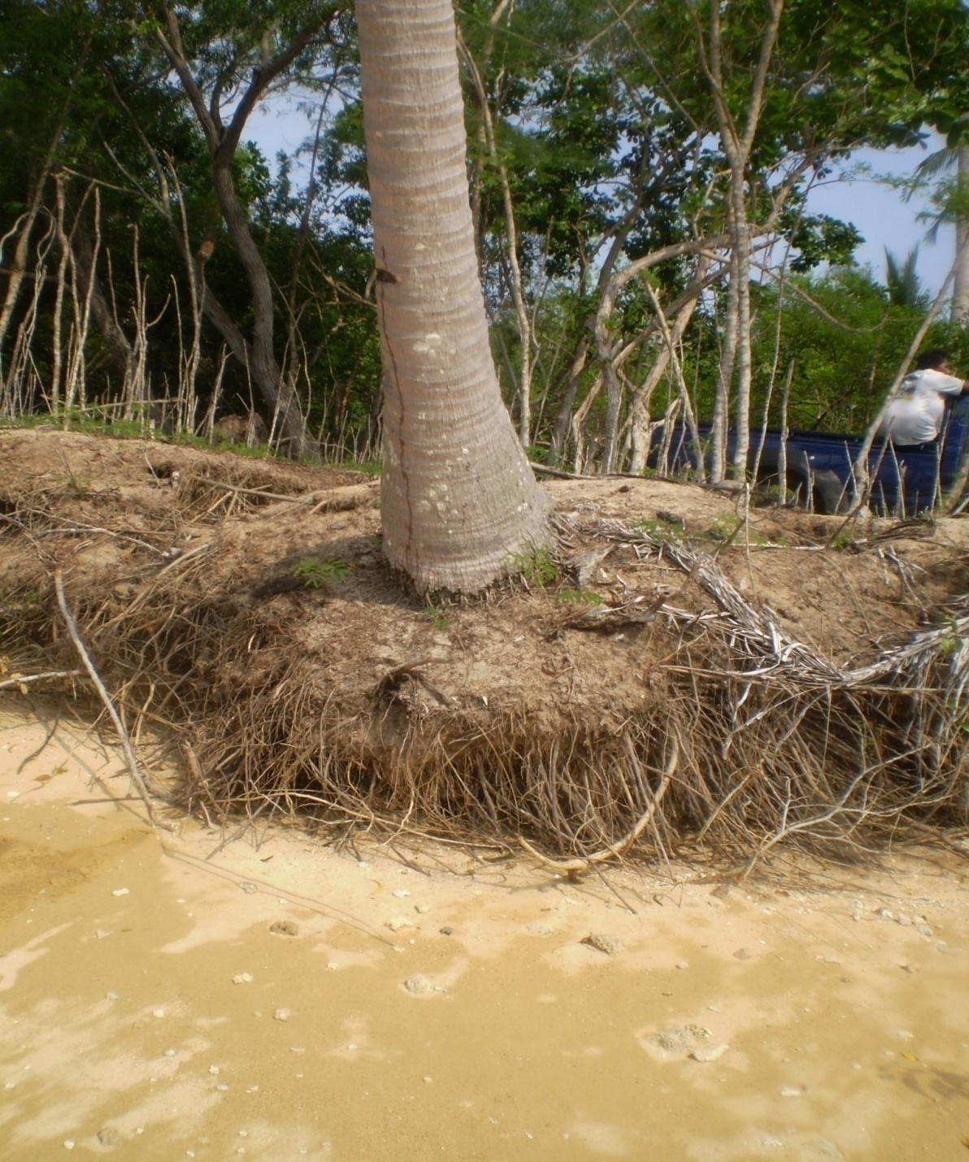
CLIMATE CHANGE IN THE VANUATU NATIONAL CURRICULUM STATEMENT

Slide 9
NATIONAL CURRICULUM STATEMENT
Section 5: Purpose of the school
Section 9: Essential cross-curriculum components
Section 10: Organizing the curriculum standards in five key learning areas

Slide 10
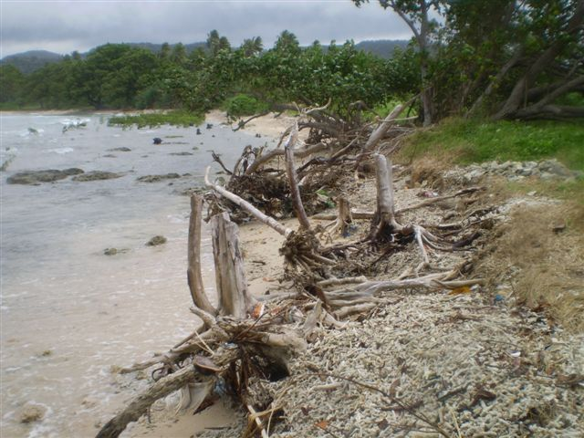
EXTRACT FROM SECTION 9 OF THE VNCS
ENVIRONMENT AND SUSTAINABLE PRODUCTION
“Every child and student needs to know how human interventions contribute to such occurrences as climate change, soil erosion, or the death of reefs, which adversely affect the environment, and how these changes impact on human lives.”

Slide 11
EXTRACTS FROM KEY LEARNING AREAS IN THE VNCS
CULTURE AND COMMUNITY
MATHEMATICS, SCIENCE AND AGRICULTURE
“A study of science will enable children and students to understand biological, physical and chemical processes that cause natural phenomena and events. They will learn about human interventions that may sometimes be beneficial while at other times may cause problems for our environment and future.”
“In order to gain a better understanding of how individuals and groups interact with each other and their environment, children and students need to investigate peoples and events that affect their own culture, resources and environment”

Slide 12
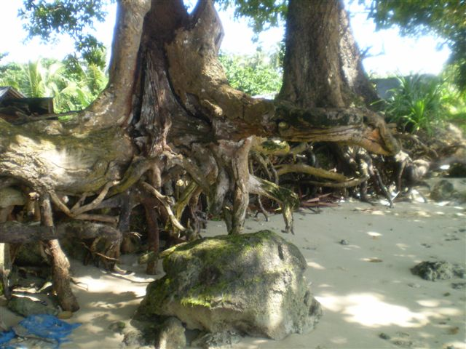

Slide 13
PROGRESS IN INTEGRATING CLIMATE CHANGE INTO THE CURRIULUM
YEARS 11-13: Several of the learning areas have already included climate change in their proposed curricula for the senior cycle. A series of CC related learning outcomes for all learning areas was developed at an SPC-GIZ sponsored Workshop in Port Vila in June 2011.
YEARS 7-10: Work on developing the new curriculum has not yet started. However, climate change is already a part of the existing Social Science curriculum for Year 10
YEARS K-6: Work on the new curriculum is in process. Sub-strand on climate change will appear in the Social Studies and Science programmes.

Slide 14
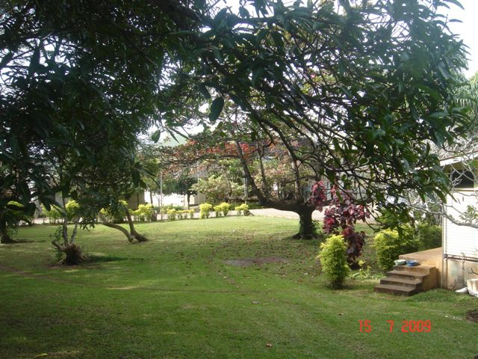
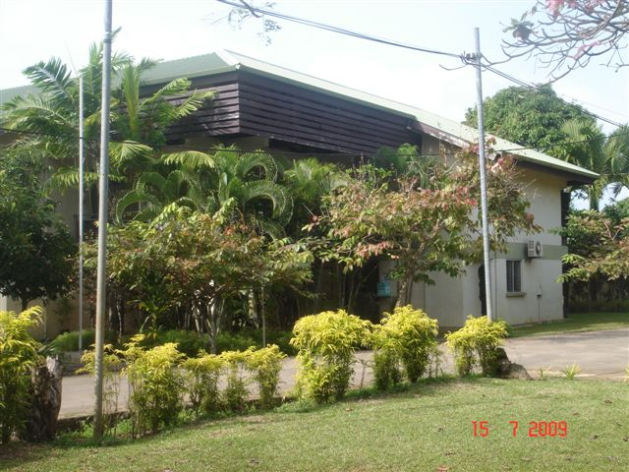
CLIMATE CHANGE IN THE NEW HARMONISED PROGRAMME AT THE VANUATU INSTITUTE OF TEACHER EDUCATION

Slide 15
HARMONISED CURRICULUM AT VITE
SCIENCE
(SCP121 OR SCP122)
CAUSES OF CC
IMPACTS OF CC
MITIGATION OF CC
YEAR 1
ALL STUDENTS
(104 in 2011)

Slide 16
HARMONISED CURRICULUM AT VITE
SOCIAL SCIENCE
(SSD211)
CAUSES OF CC
EVIDENCE FOR CC
IMPACTS OF CC
MITIGATION OF CC
INDIVIDUAL ACTION
YEAR 2
DIPLOMA STUDENTS
(25 in 2011)

Slide 17
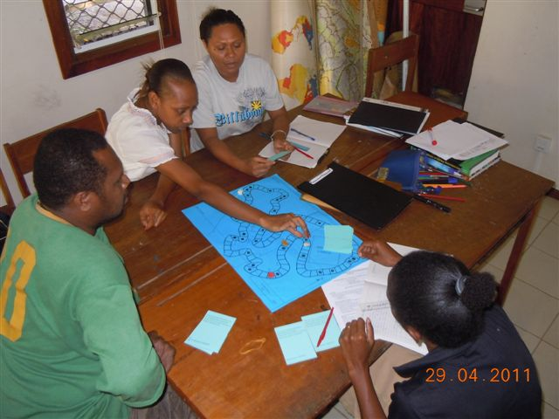

Slide 18
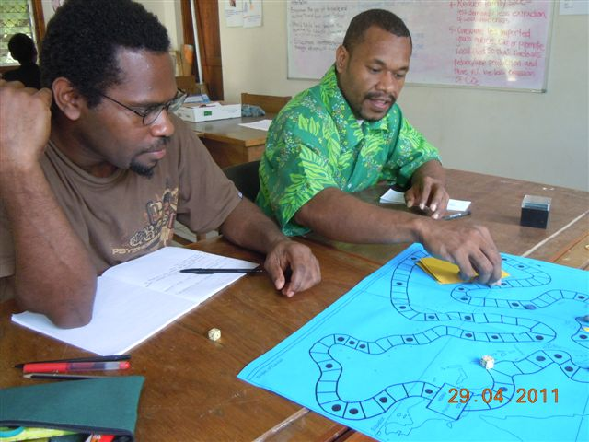

Slide 19
HARMONISED CURRICULUM AT VITE
NOT YET IN THE
PROGRAMME
YEAR 2
CERTIFICATE
STUDENTS
(60 in 2011)

Slide 20
HARMONISED CURRICULUM AT VITE
PROGRAMMES ARE STILL BEING DEVELOPED
YEAR 3
ALL
STUDENTS
(110 in 2012)

Slide 21
ASPECTS OF CLIMATE CHANGE EDUCATION AT VITE
NATURE
Greenhouse effect
Enhanced greenhouse effect
El Nino and La Nina
Ozone hole
EVIDENCE
Temperature rise
Sea level rise
Reduced ice cover
IMPACTS OF GW
Sea level rise
Climate change
Effects on food and
water resources
Effects on society
OPTIONS FOR MITIGATION
International
National
Community
Individual
POSSIBLE
CAUSES
Natural
Anthropo-
morphic

Slide 22
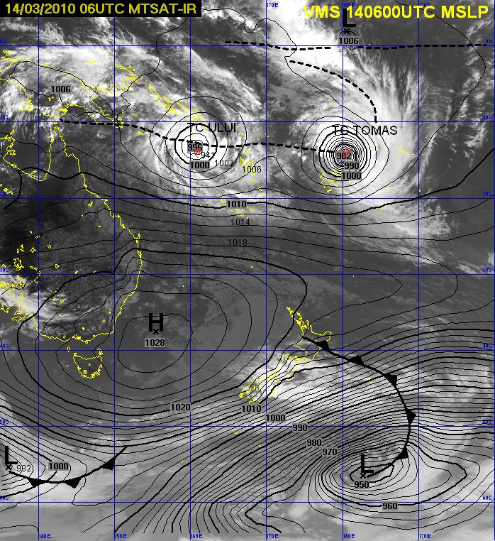
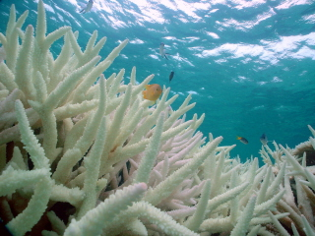
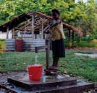
IMPACTS OF GLOBAL WARMING AND CLIMATE CHANGE

Slide 23
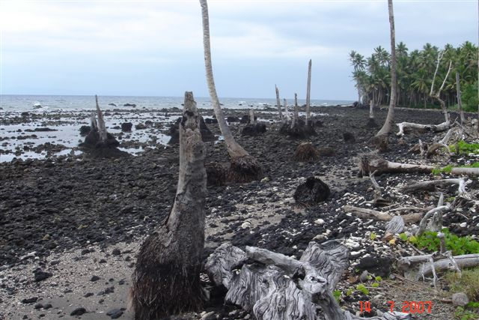
SEA LEVEL RISE NEAR SARATAMATA, AMBAE, VANUATU

Slide 24
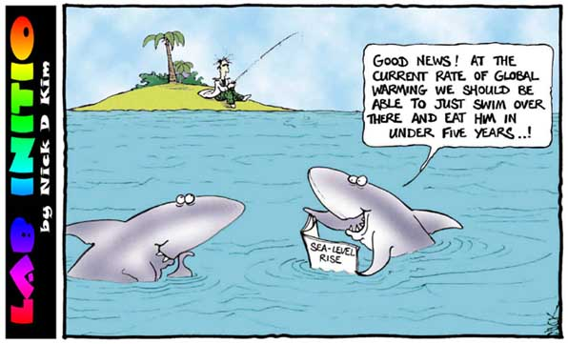

Slide 25
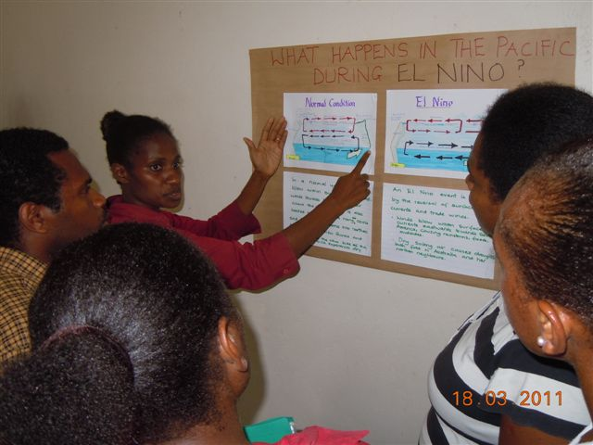
VITE: STUDENT-CENTRED ACTIVITIES TO FOSTER LEARNING ABOUT THE CAUSES, NATURE, IMPACTS AND MITIGATION OF CLIMATE CHANGE

Slide 26
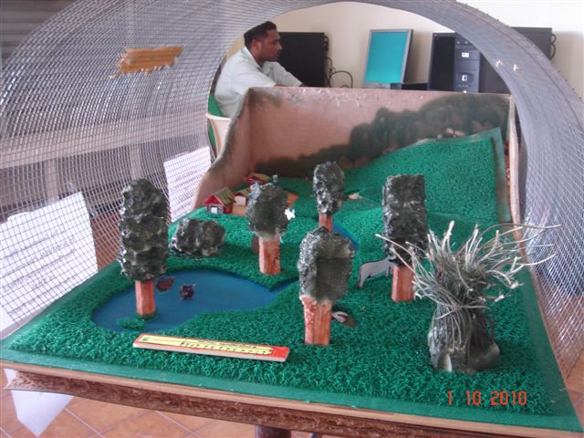
MODEL OF GREENHOUSE EFFECT: SCIENCE FEST, PORT VILA, 2010

Slide 27
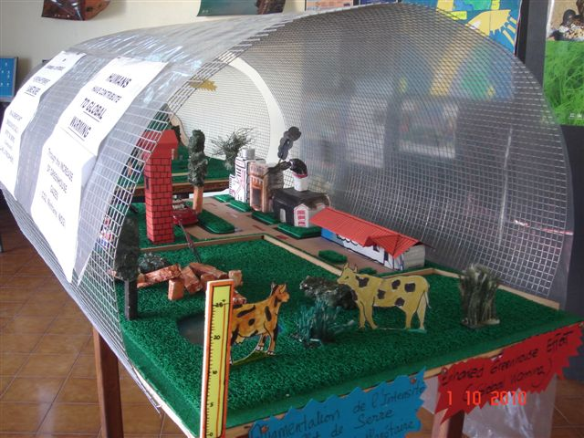
MODEL OF ENHANCED GREENHOUSE EFFECT: SCIENCE FEST, PORT VILA, 2010

Slide 28
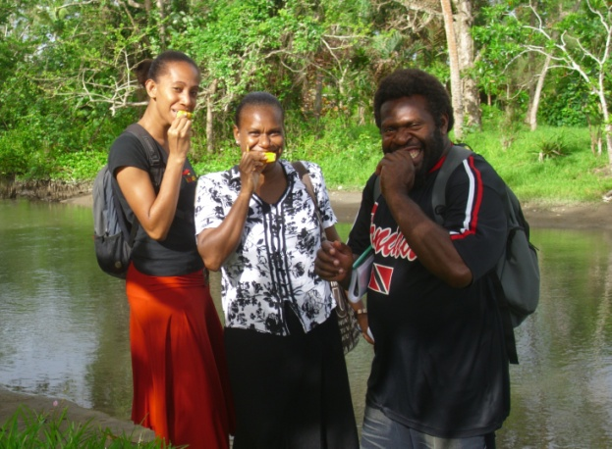
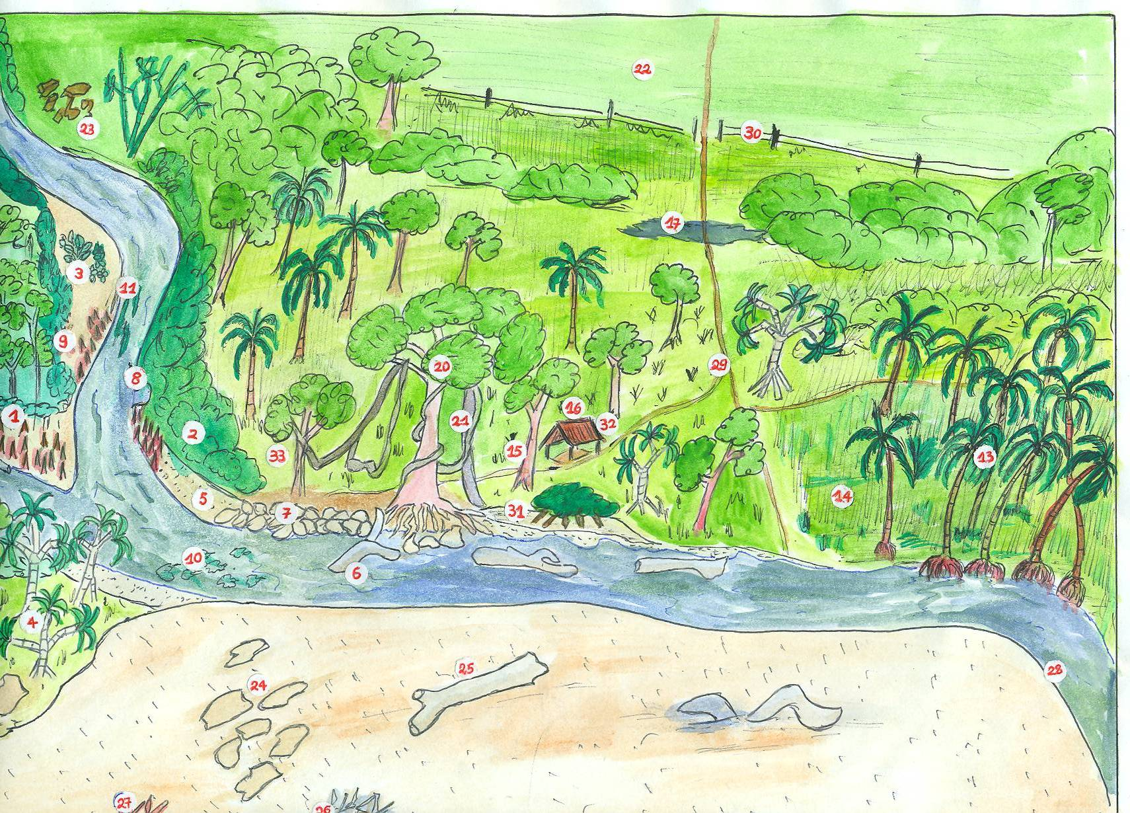
FIELD STUDY OF FACTORS CAUSING CHANGE IN AN ECOSYSTEM, MAY 2011

Slide 29
EXAMPLES OF CC ACTIVITIES FOR VITE TRAINEES IN SOCIAL SCIENCE
Study Fig. 71 (three scenarios for future temperature change) and answer these questions:
    On all three graphs, colour the CO₂ emissions line in red and the temperature line in blue
    What is meant by the “danger zone”? Shade it on all three graphs.
    When will we reach the danger zone in Scenario 1? Scenario 2? Scenario 3?
    When you look at Fig. 71, how do you feel? What has to be done?
In small groups, discuss some of the measures to slow down global warming that could be taken by:
a) Governments
b) Village communities in Vanuatu
c) You as an individual
Play the "Pacific Greenhouse Game" (This is an activity for Year 10 students in the book “Our Changing Society”.).

Slide 30
IN-SERVICE UNIT AT VITE
PROGRAMMES FOR DISTANCE LEARNING ARE STILL BEING DEVELOPED.
CLIMATE CHANGE EDUCATION COULD BE INCLUDED

Slide 31
EXAMPLE OF IN SERVICE TRAINING
RATIONALE
VITE SCIENCE DEPT CONDUCTED A SURVEY AND FOUND THAT TEACHERS IN PRIMARY SCHOOLS ARE RELUCTANT TO TEACH SCIENCE TOPICS
WORKSHOP HELD IN JULY 2011 (ASSISTED BY GIZ) FOR 40 PRIMARY TEACHERS (YRS 1-3) IN PORT VILA. TOPICS INCLUDED ENVIRONMENT AND CLIMATE CHANGE
SHORT TRAINING COURSE
TEACHERS GAINED KNOWLEDGE OF CLIMATE CHANGE AND SIMPLE CC CLASSROOM ACTIVITIES
PRIMARY CURRICULUM WRITERS CAN START TO PUT CC IN THE PRIMARY CURRICULUM
OUTCOMES

Slide 32
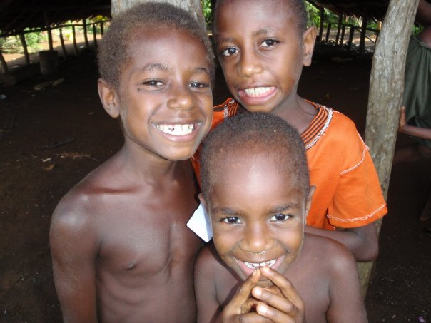
3.
CURRENT ACTIVITIES ON CLIMATE CHANGE
INFORMAL
SECTOR

Slide 33
WAN SMOL BAG THEATRE COMPANY
Performs plays and makes films to promote environmental awareness and environmental conservation.
Promotes awareness of environmental issues and climate change in schools
Encourages schools to set up their own informal “environmental protection clubs”. Such clubs already exist in Efate at Central School (English), Pango Primary School (French), Ecole Centre Ville, and Vila North (English)

Slide 34
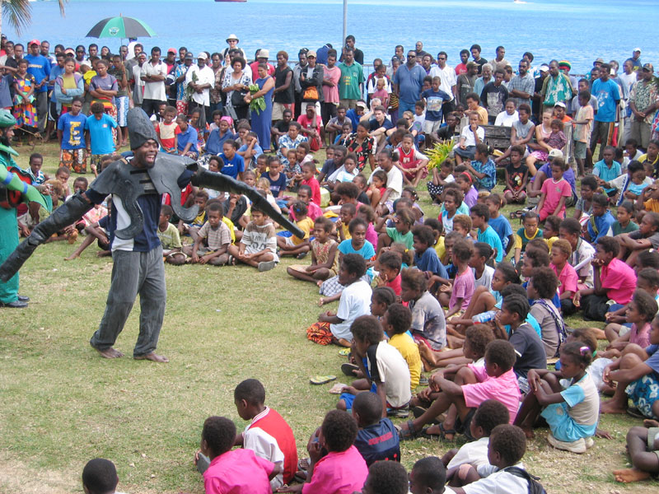

Slide 35
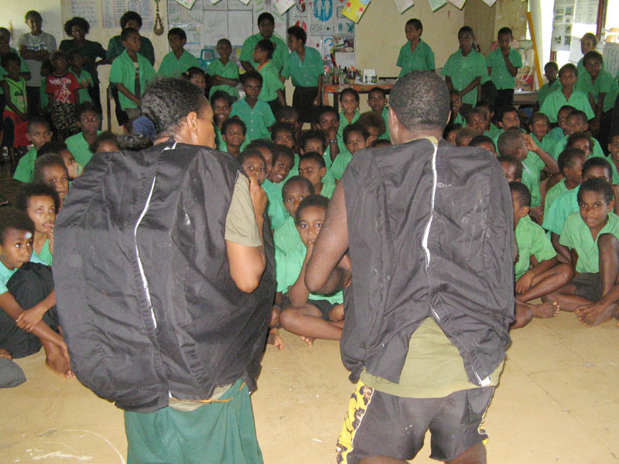

Slide 36
TVET
Looks after technical and vocational education in Vanuatu, under the Ministry of Youth Development, Sports and Training.
All TVET courses must be approved by the Vanuatu National Training Council.
Every course is offered through 40 registered training providers, e.g. Vanuatu Nursing College, Vanuatu Agricultural College, VIT, Hideaway Island Resort.

Slide 37
TVET
A few courses are providing specific education on climate change (farming as a business-GIZ).
Steps are being taken to put climate change topics into courses in agriculture, forestry, fisheries, tourism and building construction, and to trial these courses in the field, with a view to implementation in 2013.
Aspects of climate change education covered: information on change, sector specific impacts of change, and practical methods of adapting to change.

Slide 38
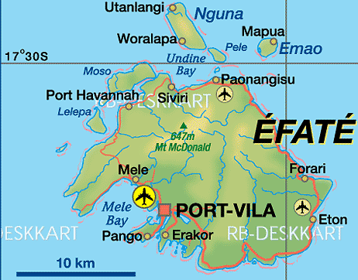
EXAMPLE OF TVET TRIALS IN AGRICULTURE
VQF LEVEL 1, 2 and 3 courses and farming as a business (FAB) are being trialled at Teouma Bush, Efate island, by the local farmers committee , Geohazards Dept. and SPC-GIZ. The aim is to collect and provide evidence of climate change and other factors, as well as how to adapt commercial farming to these changes.

Slide 39
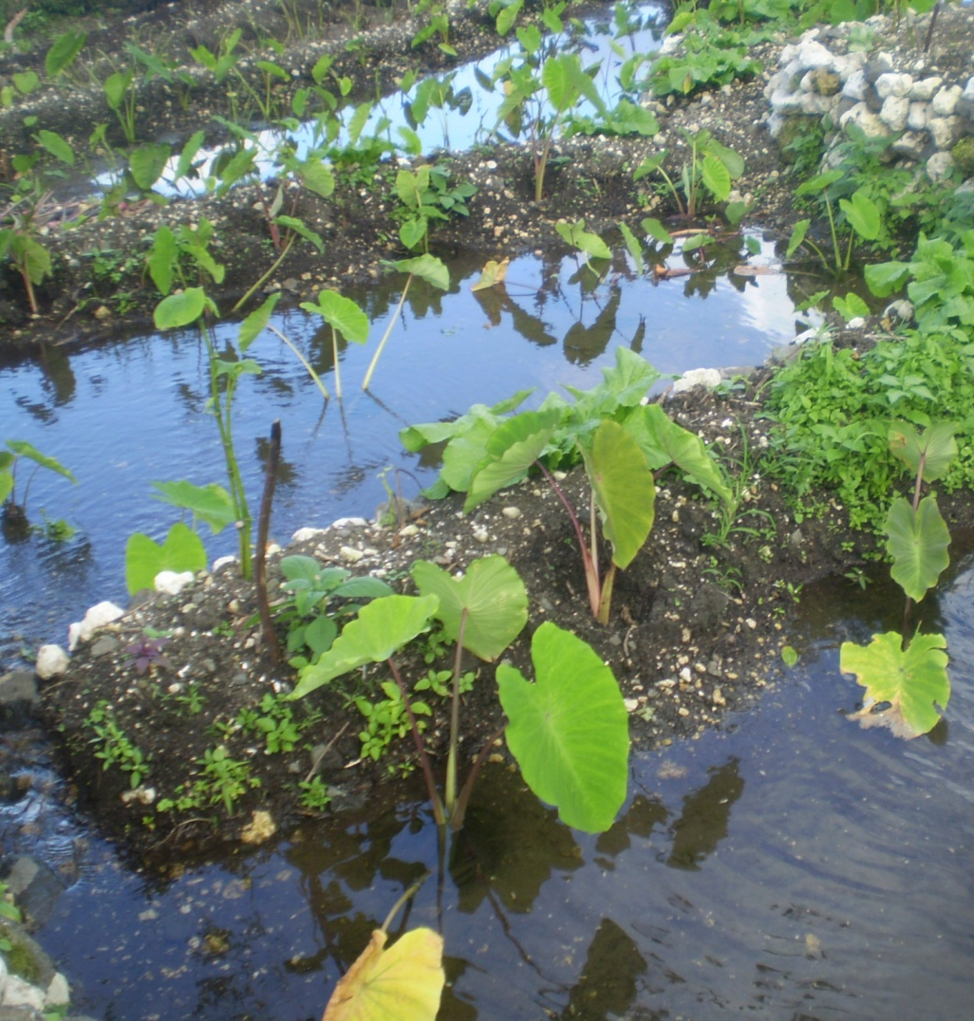
TVET EVIDENCE OF CLIMATE CHANGE
Farmers on Santo are finding that some species of taro no longer producing good yields.
Yams on Malo & Efate are being destroyed through too much rain in 2011.
Observed deterioration in the quality “laplap” leaves.
Pineapples ripen earlier.
Increase of “black pod” disease affecting cacao.

Slide 40
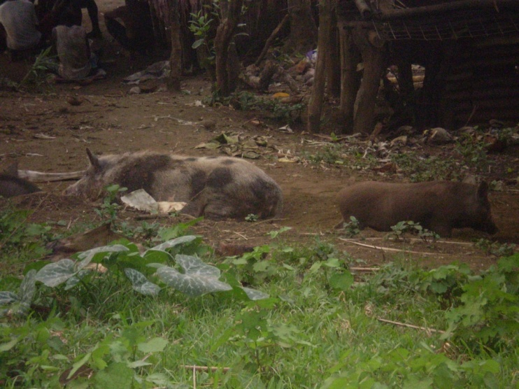
EXAMPLES OF TVET TECHNIQUES FOR ADAPTATION TO CLIMATE CHANGE
Planting of CC tolerant trees (coastal species, sandalwood, etc)
Cross-breeding of wild pigs and domestic pigs (especially on small islands) to produce animals that are more resilient to climate extremes (SPC-GIZ)
Aquaculture for livelihood diversification (15 projects on Santo)
Traditional & improved construction design

Slide 41
OTHER AREAS THAT ARE BEING (OR COULD BE) DEVELOPED IN TVET COURSES BY 2013
Protection of water sources in coastal areas and inland
Family life education
Conservation of resources - e.g. reefs, beaches, other coastal ecosystems
Further promotion of aquaculture
Further adaptation of livestock husbandry to extremes of drought and rainfall

